Slide 1
MLOps
How to do
Anton Nesterenko

Slide 2
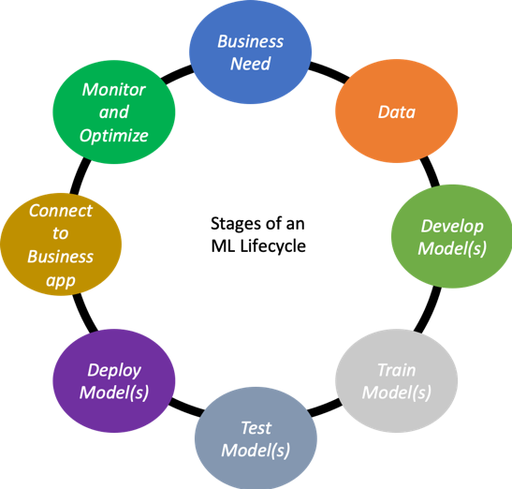
Data Science lifecycle
MLOps

Slide 3
Goals
Business need
Create a model for named entity recognition in resume
Train a model for churn prediction
Train a recommendation system for online market

Slide 4

Real goal
Business need

Slide 5
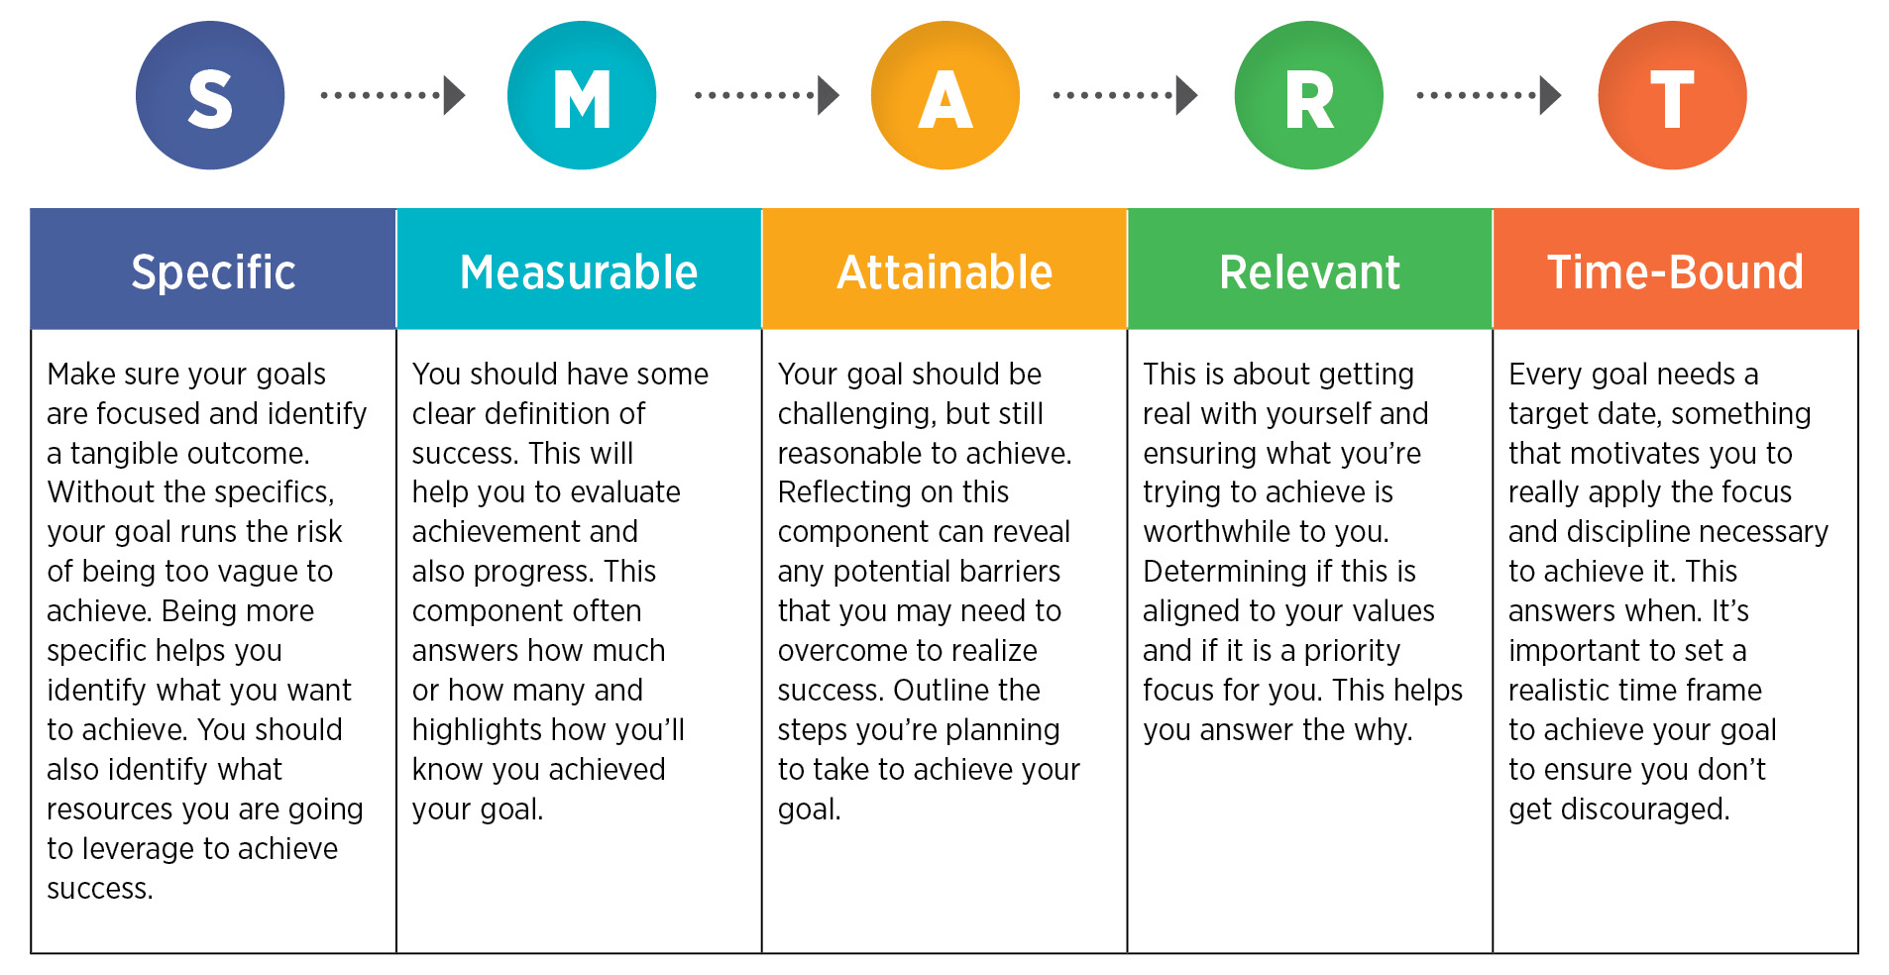
SMART
Business needs

Slide 6
Smart goals
Business needs
Decrease time for hunting person by 30% - in 2 months
Decrease churn rate by 10% in month - by 2nd April
Increase average receipt of online market by 5% - in a quarter

Slide 7
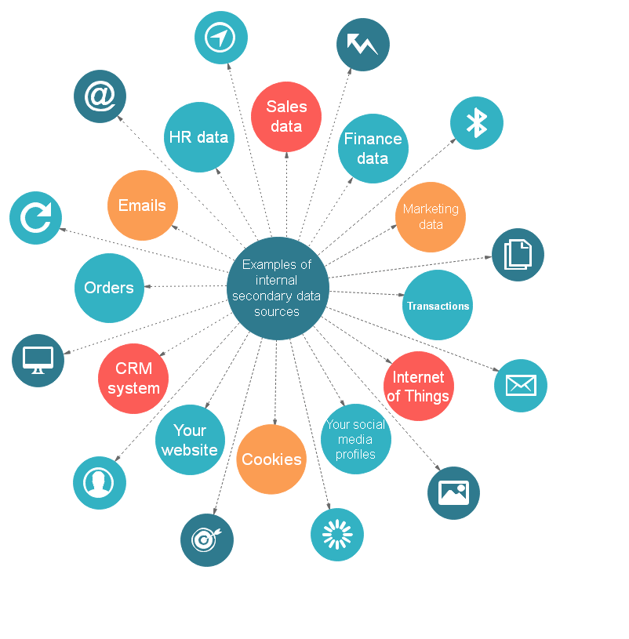
Resources
Data

Slide 8
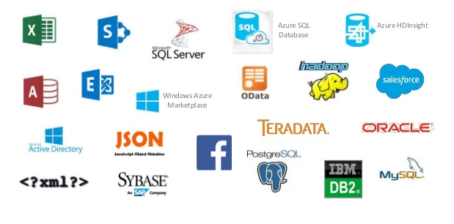
Storages
Data

Slide 9
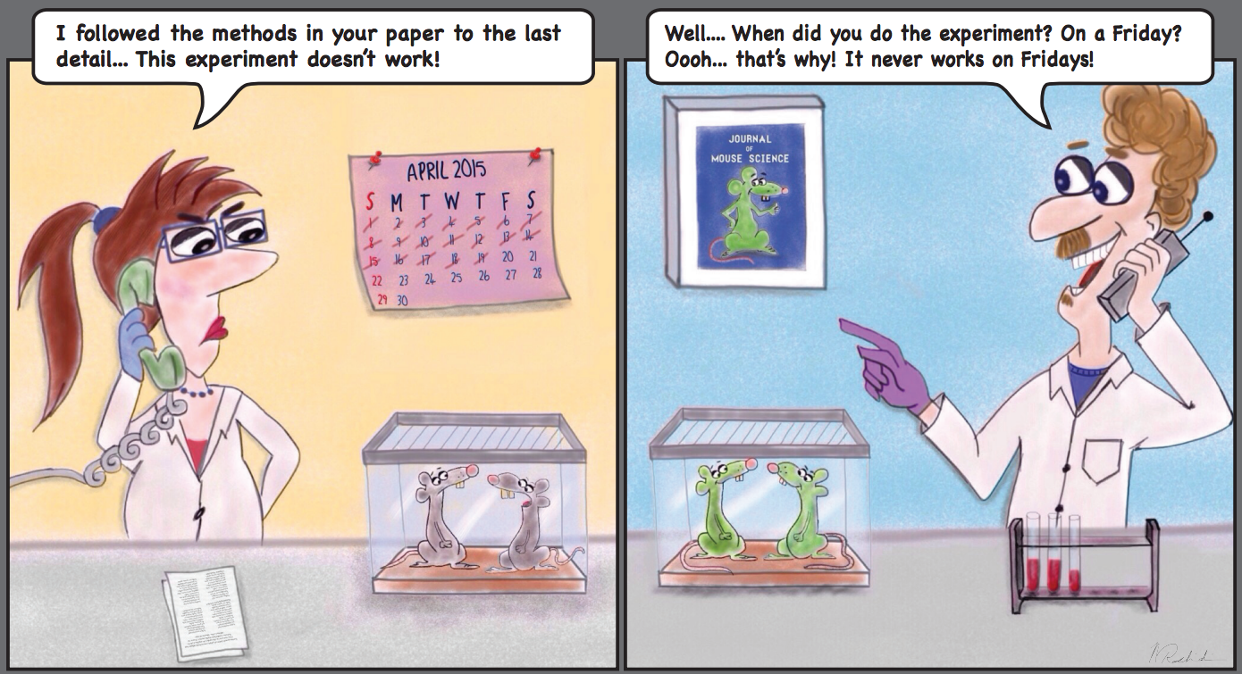
Versioning
Data

Slide 10

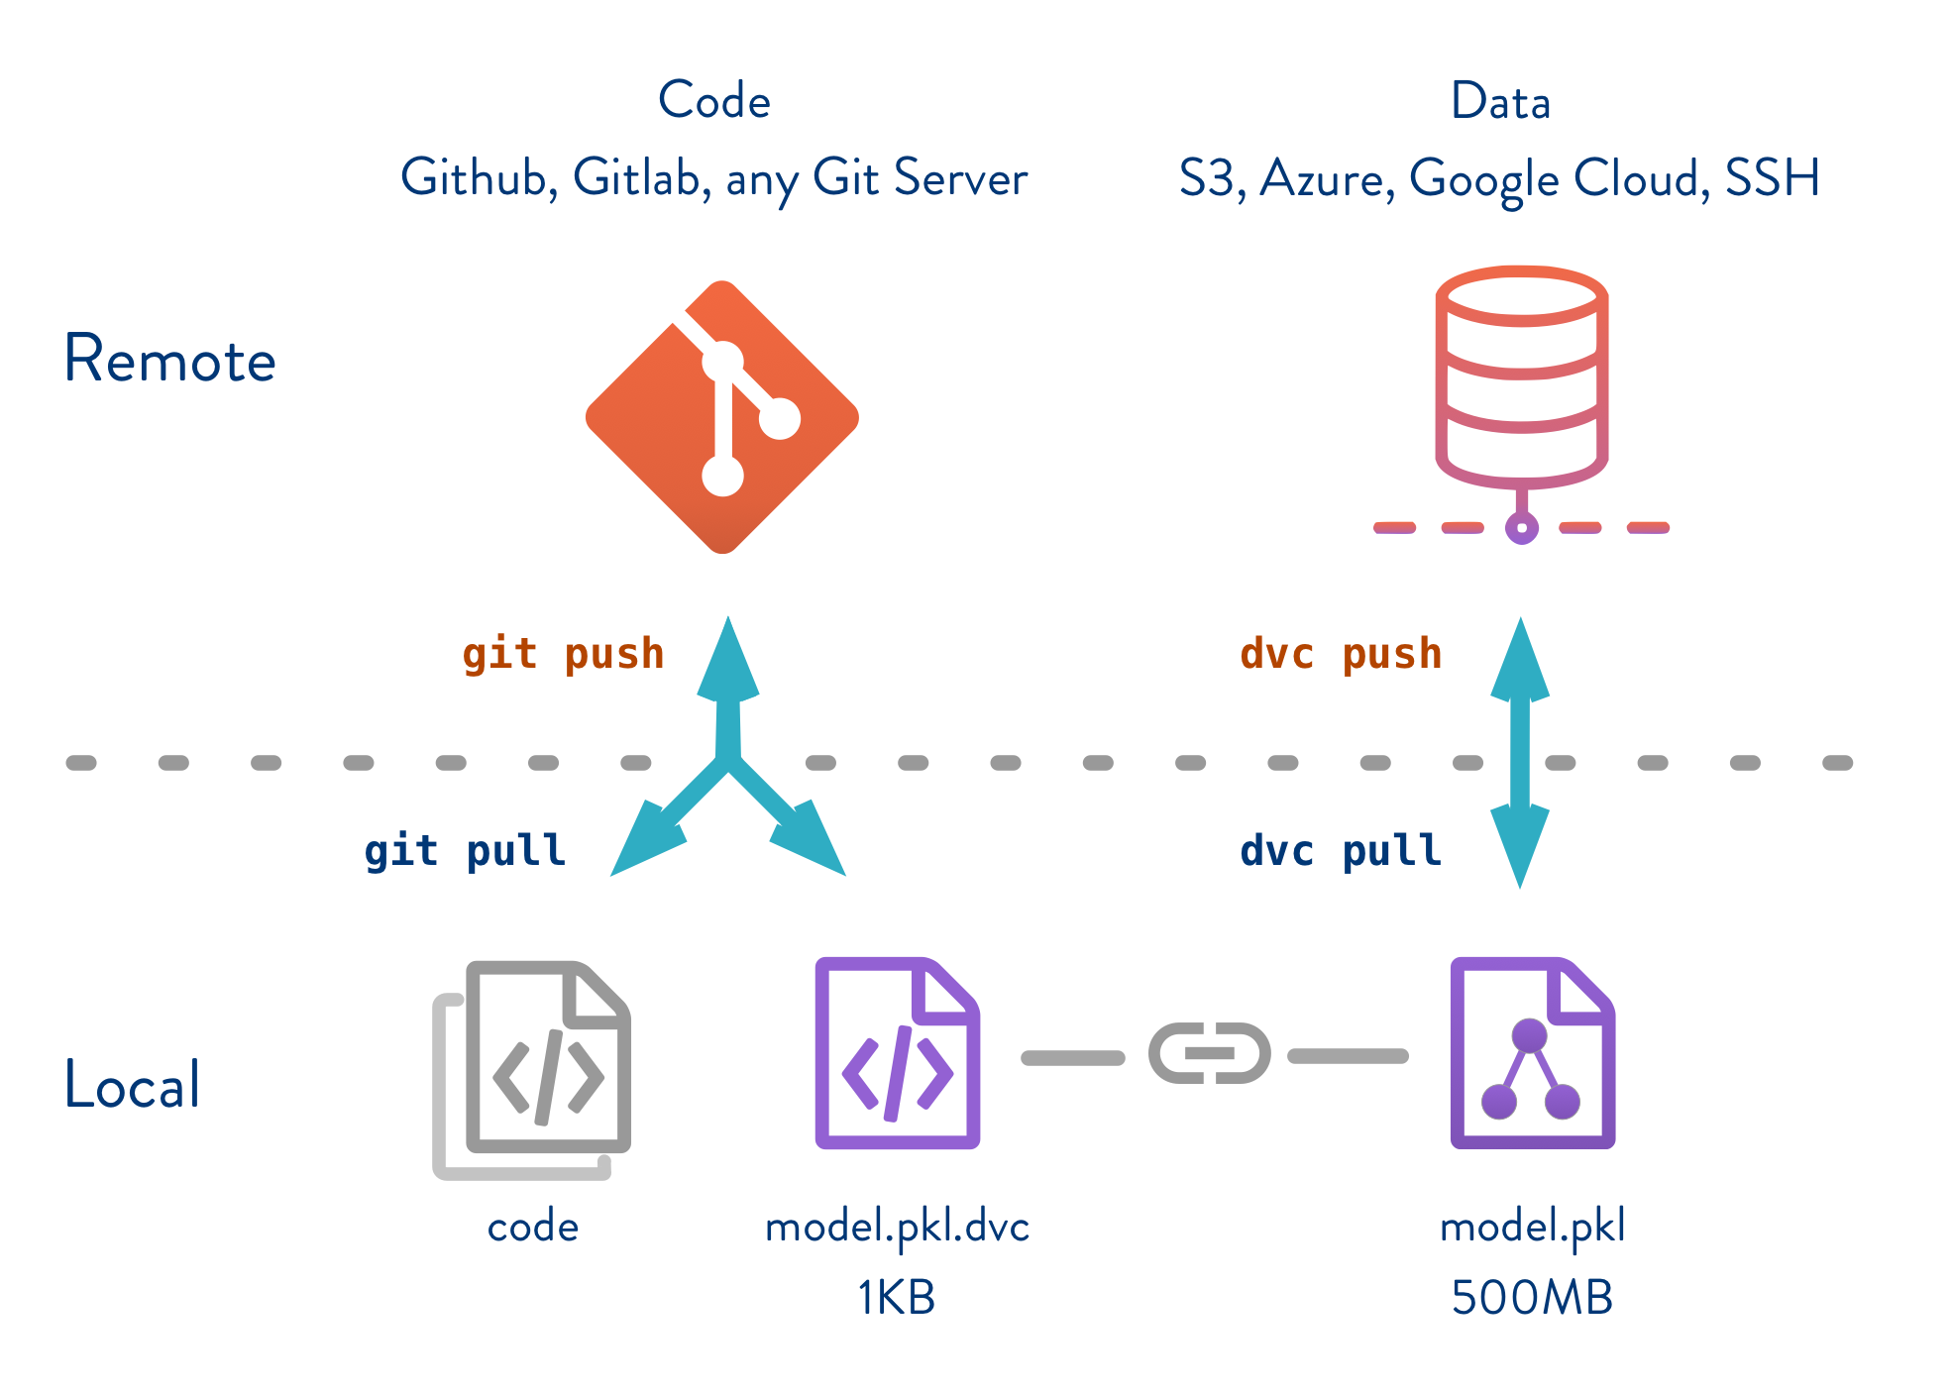
DVC
Data

Slide 11
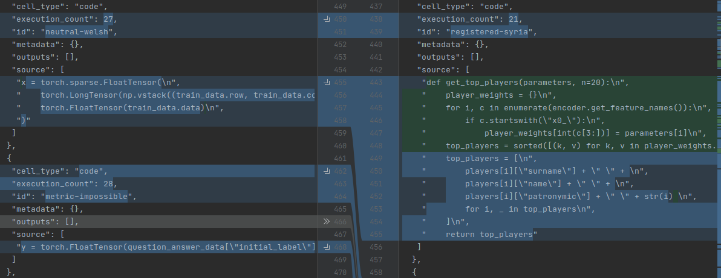
Jupyter notebook
Model develop
“+”
Visibility
“-”
Random execution order
Bad version comparison
Hardcoded parameters

Slide 12
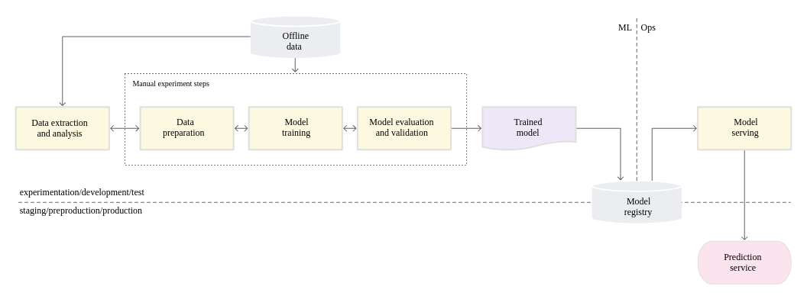
MLOps level 0
Model develop

Slide 13
EDA and py
Model develop
“+”
Straight execution order
Well structured code (possibly)
Configured parameters
Easy to compare
“-”
Visibility

Slide 14
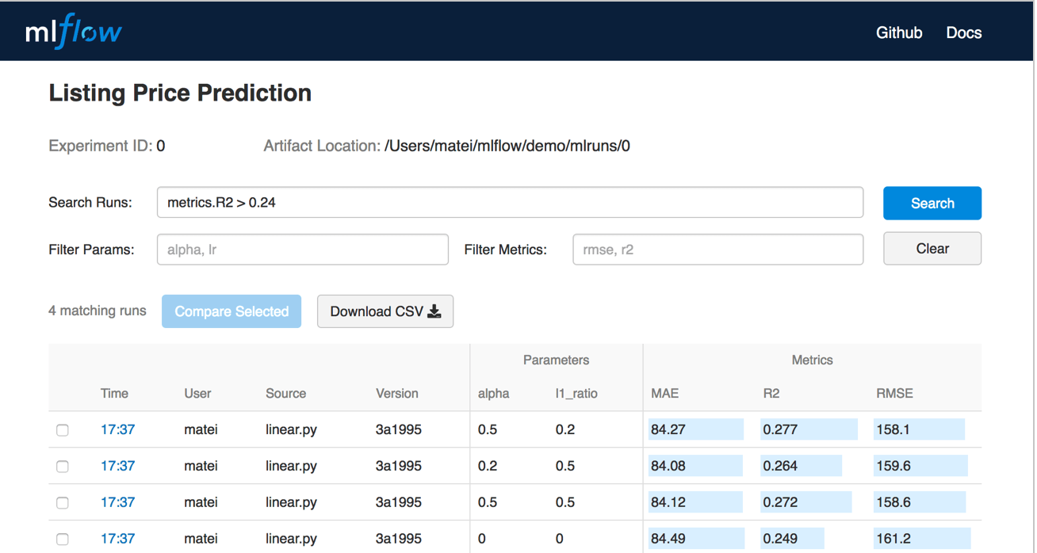
Model tracking
Model develop

Slide 15
DVC vs MLFlow
Model develop
schema: '2.0'
stages:
features:
cmd: jupyter nbconvert --execute featurize.ipynb
deps:
- path: data/clean
md5: d8b874c5fa18c32b2d67f73606a1be60
params:
params.yaml:
levels.no: 5
outs:
- path: features
md5: 2119f7661d49546288b73b5730d76485
size: 154683
- path: performance.json
md5: ea46c1139d771bfeba7942d1fbb5981e
size: 975
- path: logs.csv
md5: f99aac37e383b422adc76f5f1fb45004
size: 695947
name: My Project
conda_env: my_env.yaml
entry_points:
main:
parameters:
data_file: path
regularization: {type: float, default: 0.1}
command: "python train.py -r {regularization} {data_file}"
validate:
parameters:
data_file: path
command: "python validate.py {data_file}"

Slide 16
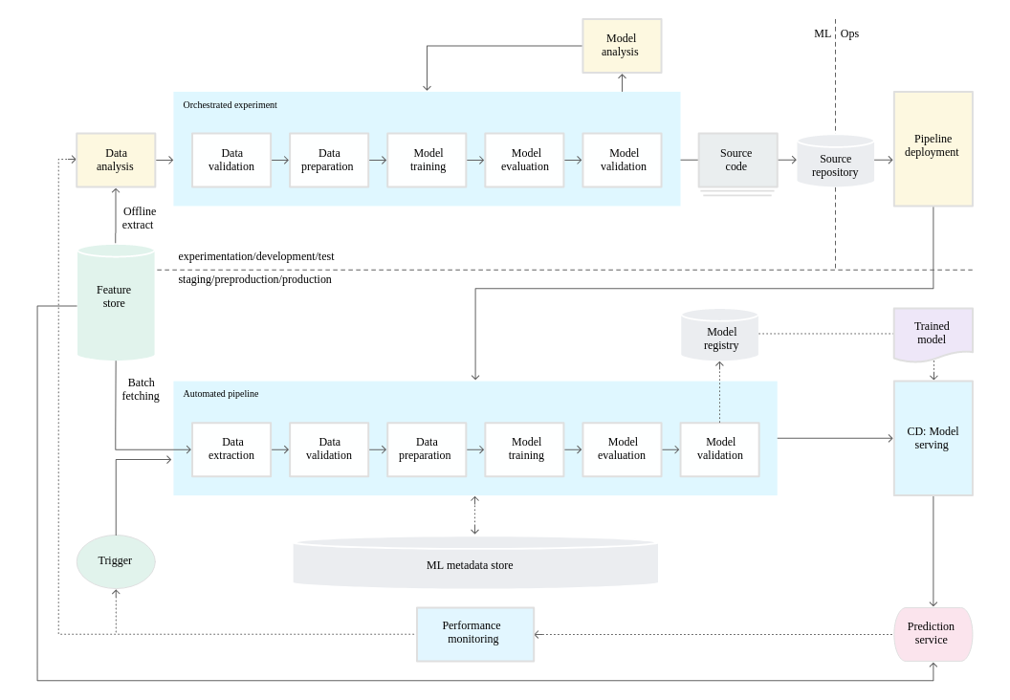
MLOps level 1
Model develop

Slide 17

Face recognition
Model deployment

Slide 18
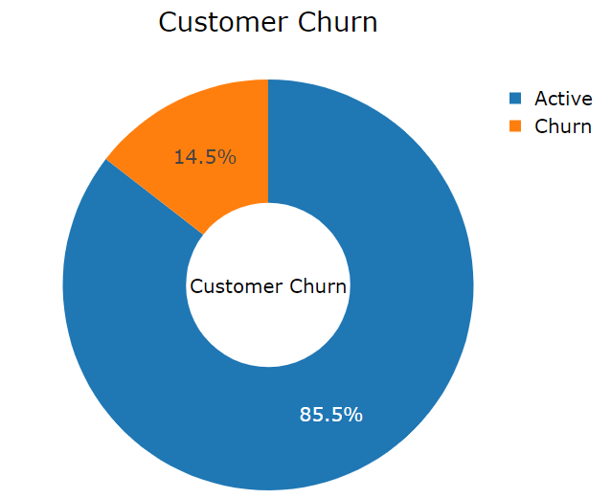
Churn detection
Model deployment

Slide 19

Sentiment analysis in delivery
Model deployment

Slide 20
Deployment types
Model deployment
Online inference
Batch inference
Near real time inference

Slide 21
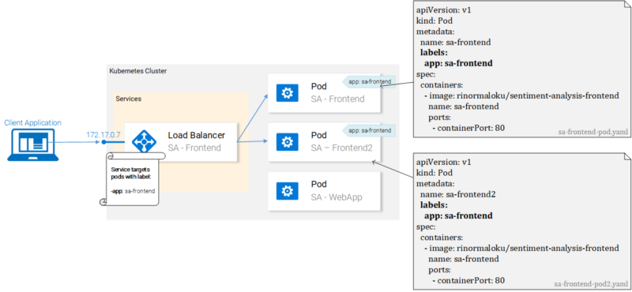
Online inference
ML Deployment

Slide 22
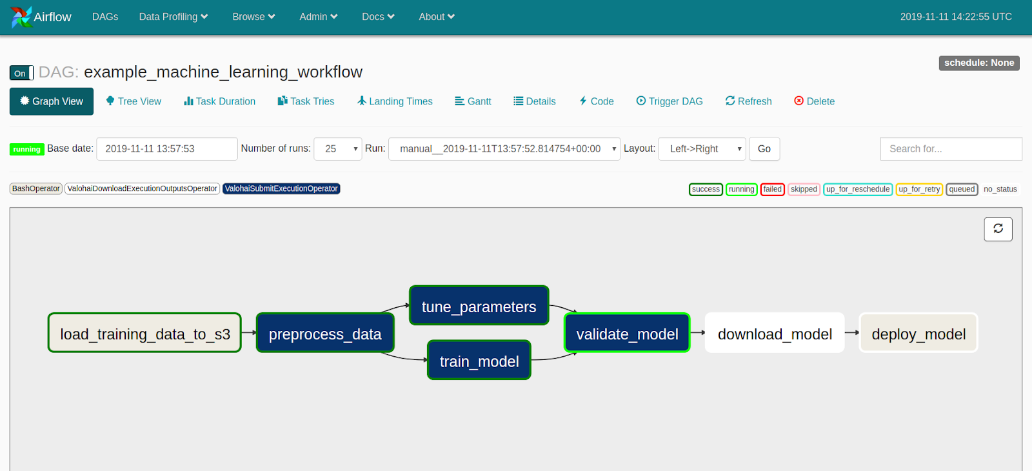
Batch inference
ML Deployment

Slide 23
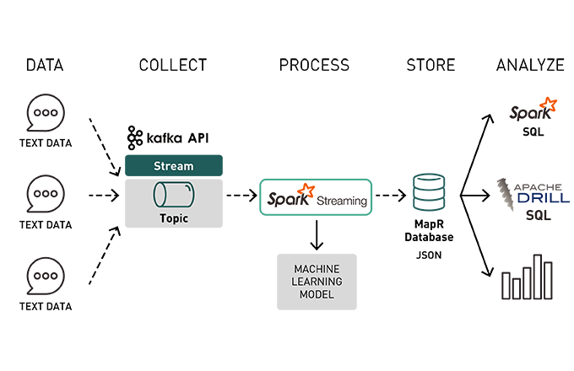
Near real time inference
ML Deployment

Slide 24
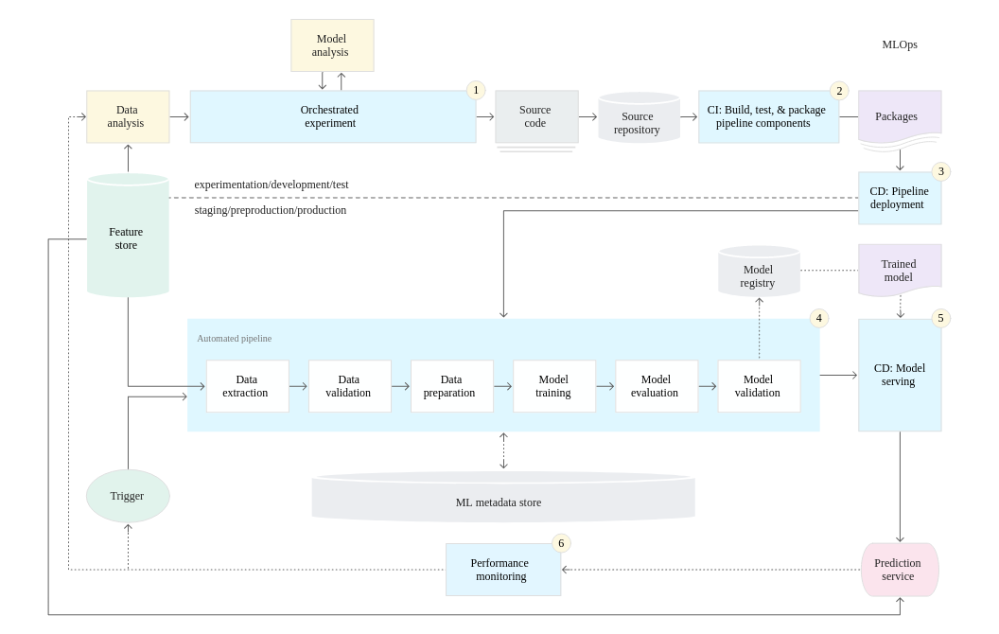
MLOps level 2
ML Deployment

Slide 25
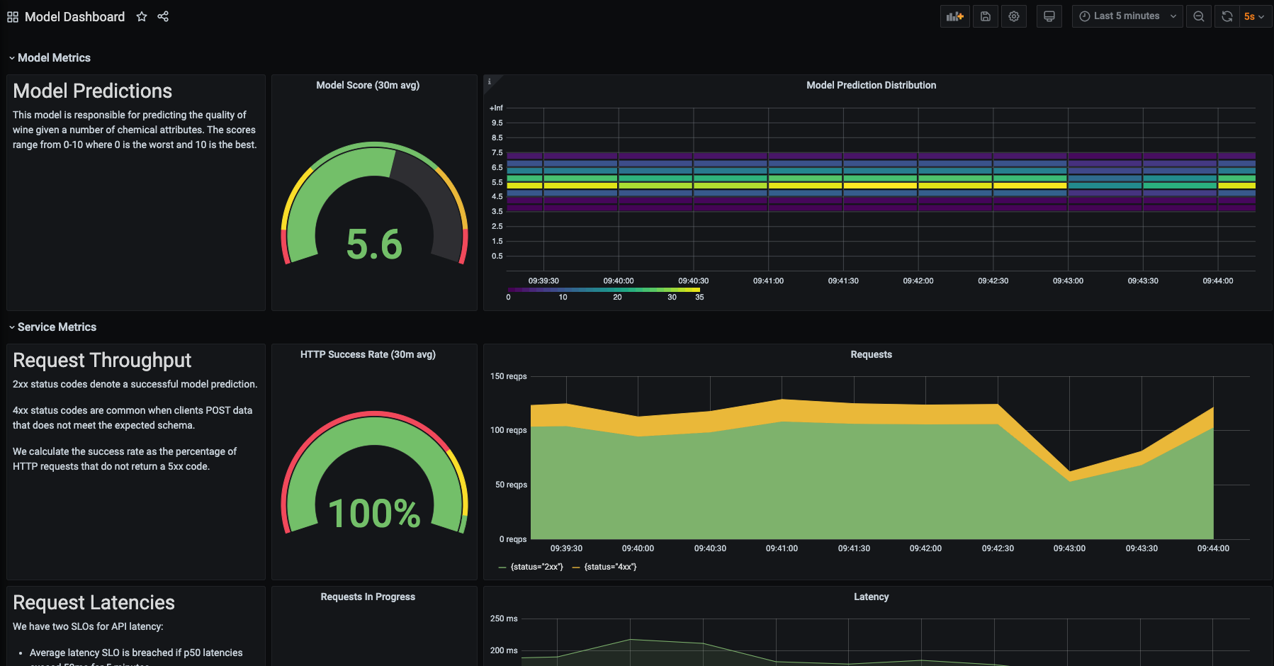
Monitoring
ML Deployment

Slide 26
Questions?
Final

